Slide 1
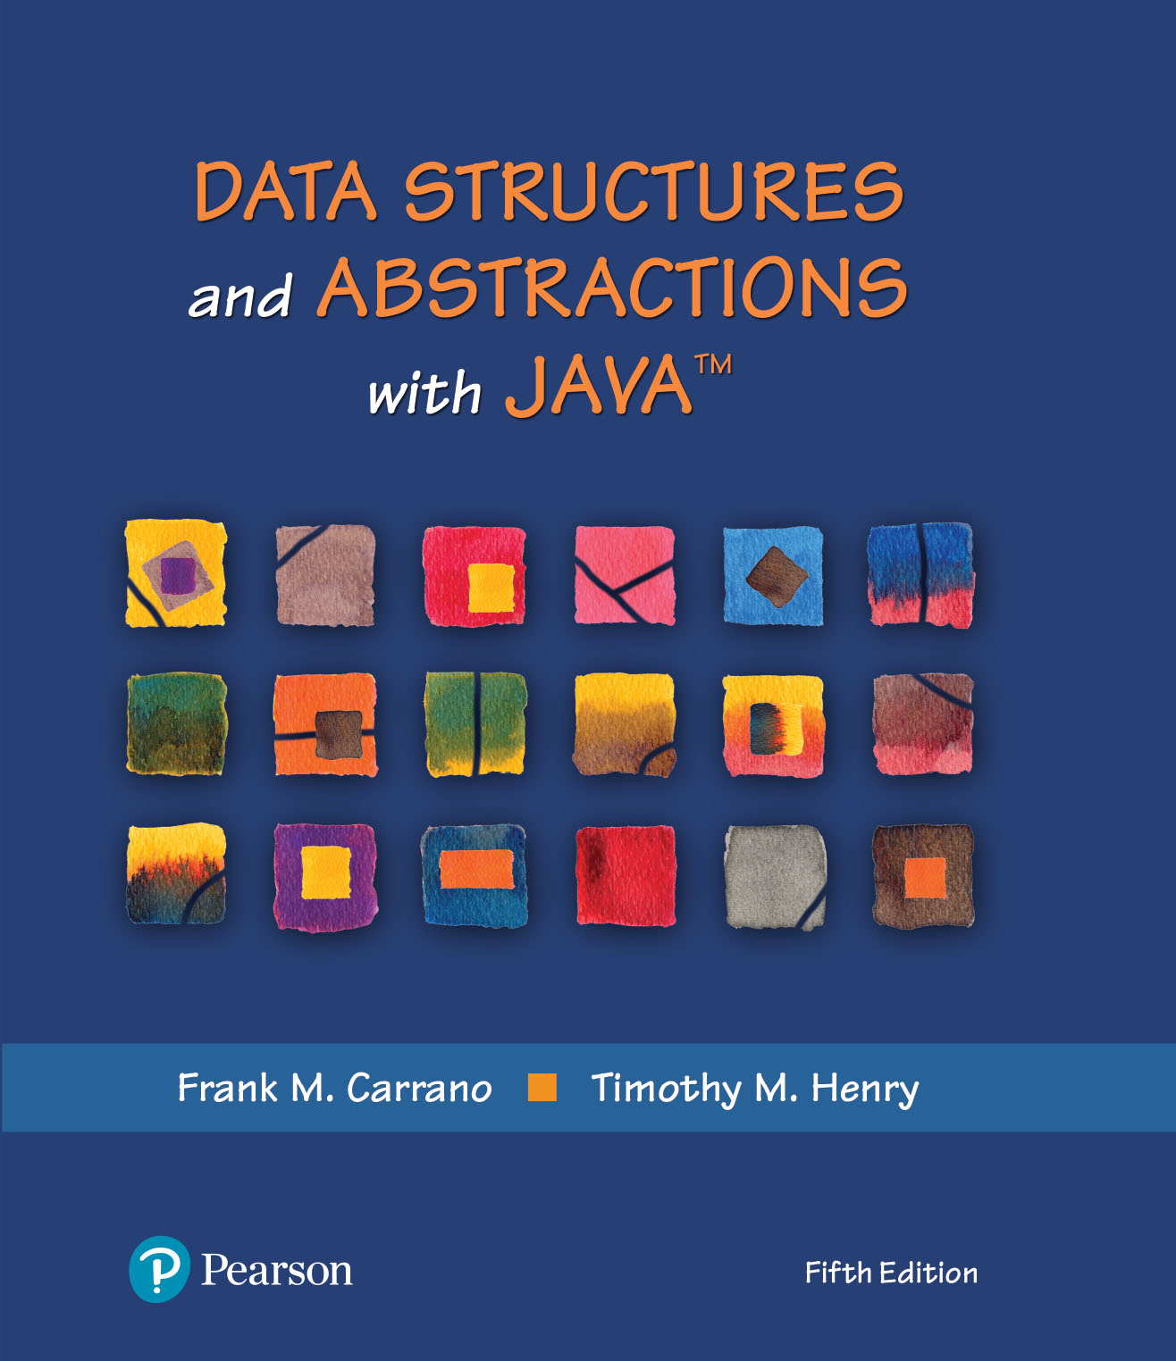
Module 18 - Sorting
Ch. 15 – Intro to Sorting
Ch. 16 – Faster Sorting

Slide 2
Video Notes
Selection Sort
https://mediaplayer.pearsoncmg.com/assets/secs-vn-ch15a-selection-sort
Merge Sort
https://mediaplayer.pearsoncmg.com/assets/secs-vn-ch16a-merge-sort
Quick Sort
https://mediaplayer.pearsoncmg.com/assets/secs-vn-ch16b-quick-sort

Slide 3
Additional Resources
Shell Sort | Derek Banas
https://www.youtube.com/watch?v=IlRyO9dXsYE
https://www.youtube.com/watch?v=f5OD9CKrZEw&list=PLGLfVvz_LVvReUrWr94U-ZMgjYTQ538nT
Visualization | Check this site out as you are learning the various sorting algorithms
https://www.hackerearth.com/practice/algorithms/sorting/bubble-sort/visualize/
Quick sort in 4 minutes
https://www.youtube.com/watch?v=Hoixgm4-P4M
Notes:
https://math.hws.edu/eck/js/sorting/xSortLab.html

Slide 4
Sorting
Ordering items | Ascending or descending
Sorting algorithms
Bubble & Selection
Insertion and Shell
Merge, Quick, Radix & Binary Search Tree
Sorting algorithms are evaluated based on
Speed
Amount of memory overhead they require
Programming effort required to implement them (just like data structures)
Each of the above sorts has its merits
4
4

Slide 5
Sorting Strategies
We seek algorithms to arrange items, ai such that: entry 1 ≤ entry 2 ≤ . . . ≤ entry n
Sorting an array is usually easier than sorting a chain of linked nodes
Sorting takes time, therefore we need
Fast algorithms O(log2n)
Should we ?
Store sorted data (good for mostly fetch operations)
Sort before output
Write once, read many
5

Slide 6
Sorting Algorithm Speed
All sorting algorithms repeatedly
Compare two items
Swap them if they are out of order
Speed of a sorting algorithm is dependent on
Number of comparisons it makes
Number of data swaps it makes
Minimize these operations
When sorting nodes, shallow swaps save time
Efficiency of a sorting algorithm is significant
Search vs. Sort
Google, other real world examples
6
Notes:
Compare & contrast

Slide 7
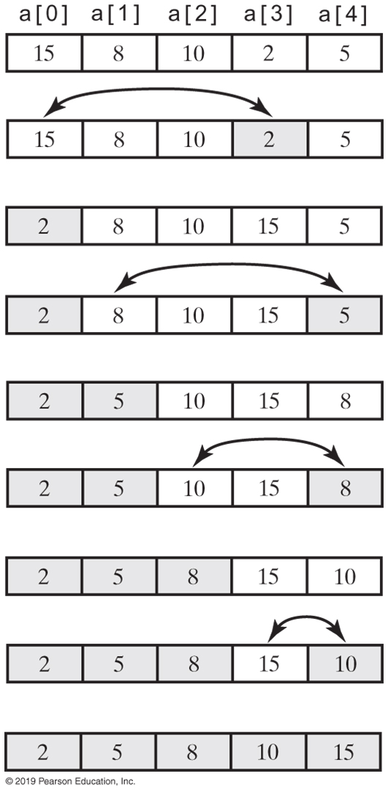
Selection Sort
A selection sort of an array of integers into ascending order
Notes:
Look for the smallest value (compares)
Swap with the “1st” element

Slide 8
Selection Sort Efficiency
Selection sort is O(n²) regardless of the initial order of the entries
Requires O(n²) comparisons
Does only O(n) swaps

Slide 9
Selection Sort | Iterative (1 of 3)
/** A class of static, iterative methods for sorting an array of
Comparable objects from smallest to largest. */
public class SortArray
{
/** Sorts the first n objects in an array into ascending order.
@param a An array of Comparable objects.
@param n An integer > 0. */
public static <T extends Comparable<? super T>>
void selectionSort(T[] a, int n)
{
for (int index = 0; index < n - 1; index++)
{
int indexOfNextSmallest = getIndexOfSmallest(a, index, n - 1);
swap(a, index, indexOfNextSmallest);
} // end for
} // end selectionSort

Slide 10
Selection Sort | Iterative (2 of 3)
// Finds the index of the smallest value in a portion of an array a.
// Precondition: a.length > last >= first >= 0.
// Returns the index of the smallest value among
// a[first], a[first + 1], . . . , a[last].
private static <T extends Comparable<? super T>>
int getIndexOfSmallest(T[] a, int first, int last)
{
T min = a[first];
int indexOfMin = first;
for (int index = first + 1; index <= last; index++)
{
if (a[index].compareTo(min) < 0)
{
min = a[index];
indexOfMin = index;
} // end if
// Assertion: min is the smallest of a[first] through a[index].
} // end for
return indexOfMin;
} // end getIndexOfSmallest

Slide 11
Selection Sort | Iterative (3 of 3)
// Swaps the array entries a[i] and a[j].
private static void swap(Object[] a, int i, int j)
{
Object temp = a[i];
a[i] = a[j];
a[j] = temp;
} // end swap
} // end SortArray

Slide 12
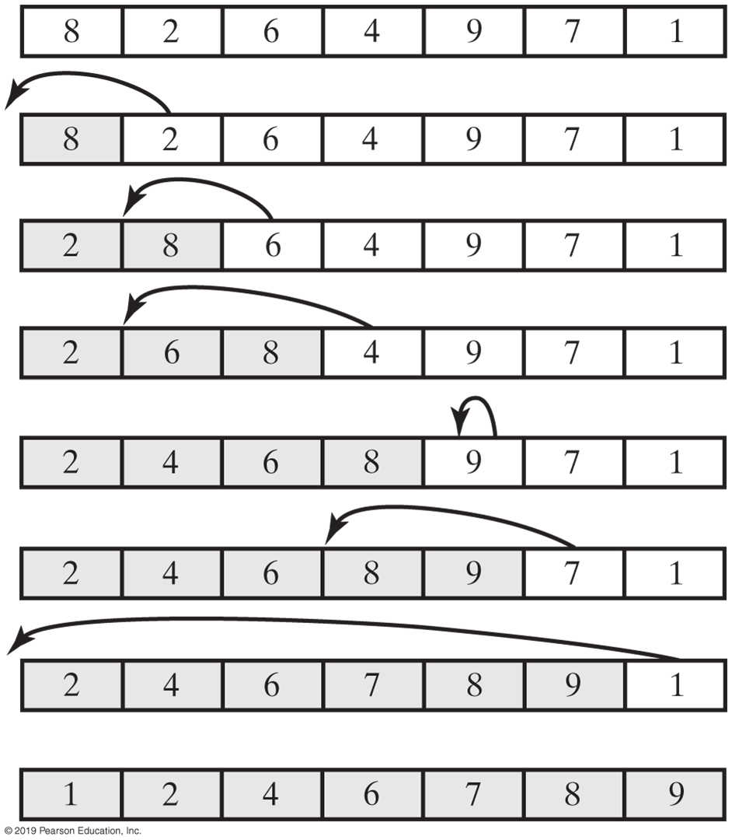
Insertion Sort (1 of 2)
An insertion sort of an array of integers into ascending order

Slide 13
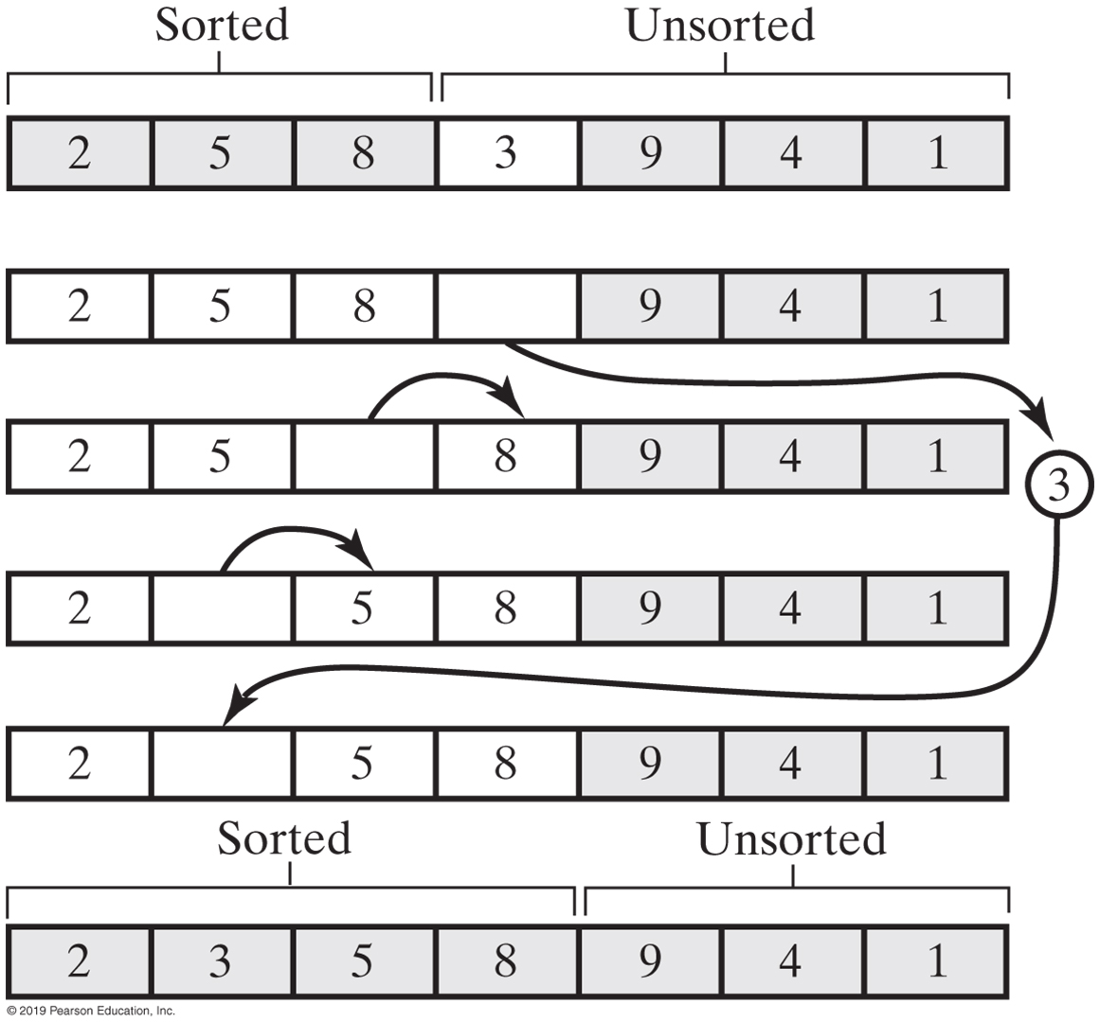
Insertion Sort (2 of 2)
Notes:
Inserting the next unsorted entry into its proper location within the sorted portion of an array during an insertion sort

Slide 14
Insertion Sort | Recursive
public static <T extends Comparable<? super T>>
void insertionSort(T[] a, int first, int last)
{
if (first < last)
{
// Sort all but the last entry
insertionSort(a, first, last - 1);
// Insert the last entry in sorted order
insertInOrder(a[last], a, first, last - 1);
} // end if
} // end insertionSort

Slide 15
Insertion Sort | Recursive
Algorithm insertInOrder(anEntry, a, begin, end)
// Inserts anEntry into the sorted array entries a[begin] through a[end].
// Revised draft.
if (anEntry >= a[end])
a[end + 1] = anEntry
else if (begin < end)
{
a[end + 1] = a[end]
insertInOrder(anEntry, a, begin, end − 1)
}
else // begin == end and anEntry < a[end]
{
a[end + 1] = a[end]
a[end] = anEntry
}
Notes:
The algorithm insertInOrder: final draft.
Note: insertion sort efficiency (worst case) is O(n²)

Slide 16
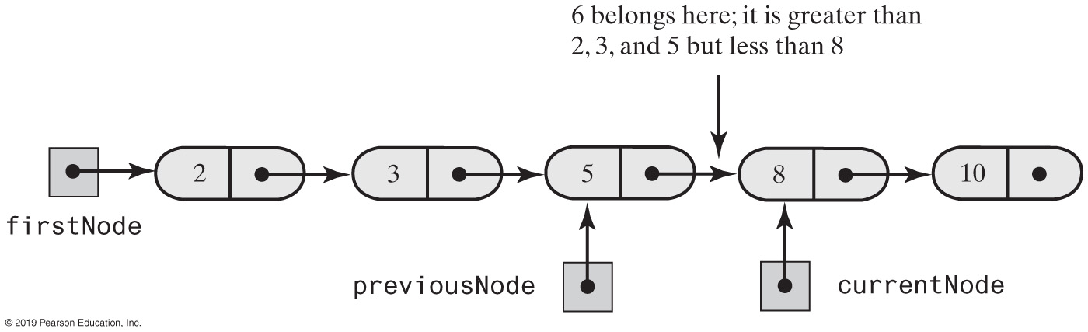
Insertion Sort | Linked Chain
During the traversal of a chain to locate the insertion point, save a reference to the node before the current one

Slide 17
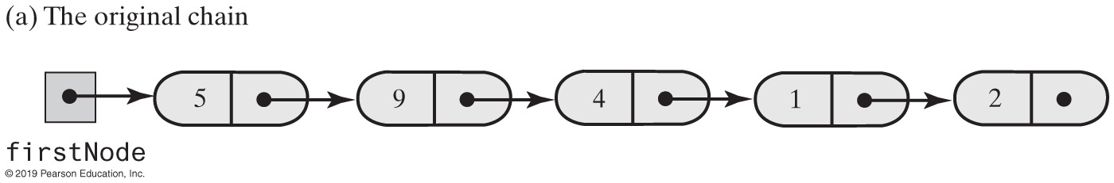
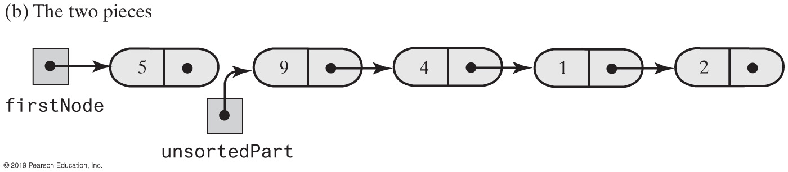
Insertion Sort | Linked Chain
Breaking a chain of nodes into two pieces as the first step in an insertion sort

Slide 18
Shell Sort
Algorithms so far are simple
Inefficient for large arrays at O(n²)
The more sorted an array is, the less work insertInOrder() must do
Improved insertion sort developed by Donald Shell

Slide 19
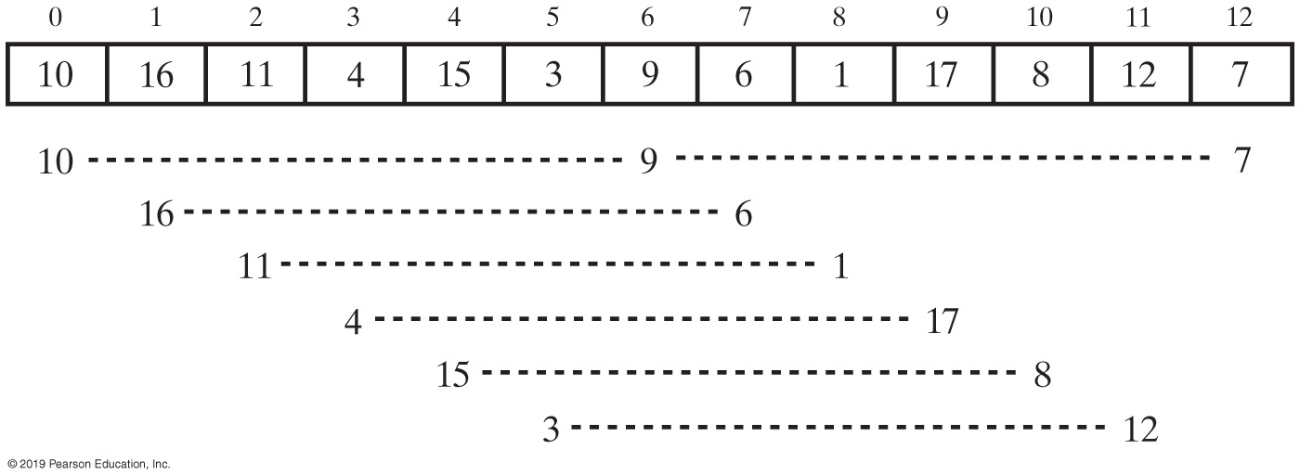
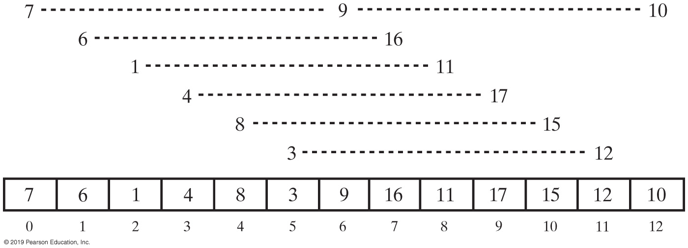
Shell Sort (1 of 2)
Before Ordering
After Ordering
An array and the groups of entries whose indices are 6 apart before and after ordering groups

Slide 20
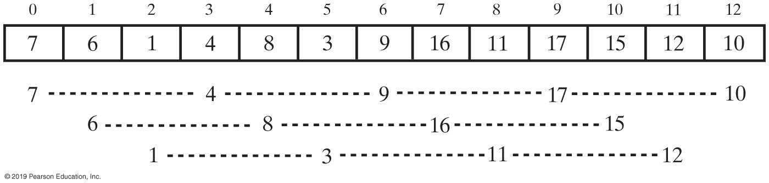
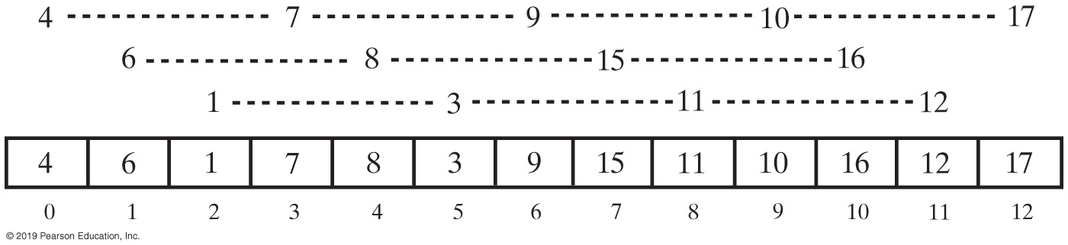
Shell Sort (2 of 2)
Before Ordering
After Ordering
Grouped entries in the array whose indices are 3 apart before and after ordering groups

Slide 21
Activity: Shell Sort
Index
0 | 1 | 2 | 3 | 4 | 5 | 6 | 7 | 8 | 9 | 10 | 11 | 12
123 | 398 | 210 | 19 | 528 | 3 | 49 | 99 | 513 | 129 | 7 | 220 | 294
6 Apart (N / 2)
3
1
Notes:
https://www.programiz.com/dsa/shell-sort
https://www.udemy.com/tutorial/data-structures-and-algorithms-deep-dive-using-java/shell-sort-implementation/
https://www.linkedin.com/learning/introduction-to-data-structures-algorithms-in-java/shell-sort
https://www.codingeek.com/algorithms/shell-sort-algorithm-explanation-implementation-and-complexity/
https://www.tutorialspoint.com/data_structures_algorithms/shell_sort_algorithm.htm
http://www.java2s.com/Code/Java/Collections-Data-Structure/Shellsort.htm

Slide 22
Comparing Algorithms
 | Best Case | Average Case | Worst Case
Selection Sort | O(n²) | O(n²) | O(n²)
Insertion Sort | O(n) | O(n²) | O(n²)
Shell Sort | O(n) | O(n^{1.5}) | O(n^{1.5})
The time efficiencies of three sorting algorithms, expressed in Big Oh notation

Slide 23
Merge Sort
Divides an array into halves
Sorts the two halves
Then merges them into one sorted array
The algorithm for merge sort is usually stated recursively
Major programming effort is in the merge process
Watch provided video

Slide 24
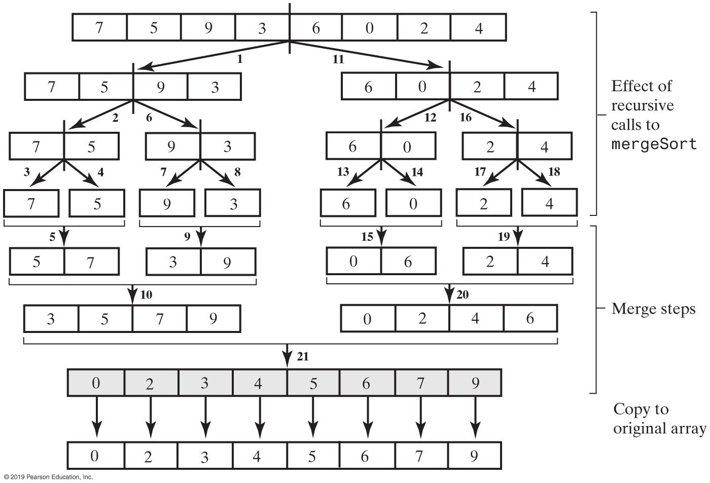
Merge Sort
The effect of the recursive calls and the merges during a merge sort

Slide 25
Activity: Merge Sort
Index
0 | 1 | 2 | 3 | 4 | 5 | 6 | 7 | 8 | 9 | 10 | 11 | 12
123 | 398 | 210 | 19 | 528 | 3 | 49 | 99 | 513 | 129 | 7 | 220 | 294

Slide 26
Merge Sort | Java Class Library
Class Arrays in the package java.util defines versions of a static method sort
public static void parallelSort(Object[] a)
public static void parallelSort(Object[] a, int first, int after)

Slide 27
Quick Sort
Divides an array into two pieces
Pieces are not necessarily halves of the array
Chooses one entry in the array—called the pivot
Partitions the array
When pivot chosen, array rearranged such that:
Pivot is in position that it will occupy in final sorted array
Entries in positions before pivot are less than or equal to pivot
Entries in positions after pivot are greater than or equal to pivot
Watch provided video

Slide 28
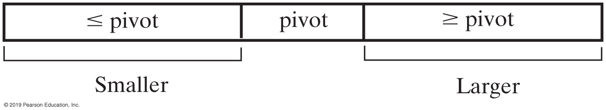
Quick Sort
A partition of an array during a quick sort

Slide 29
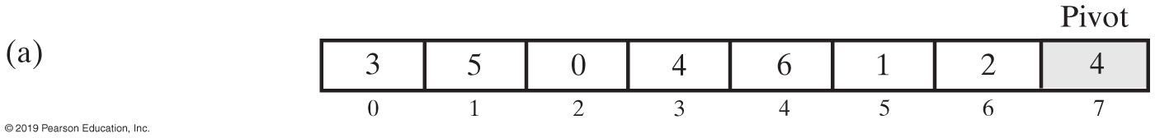
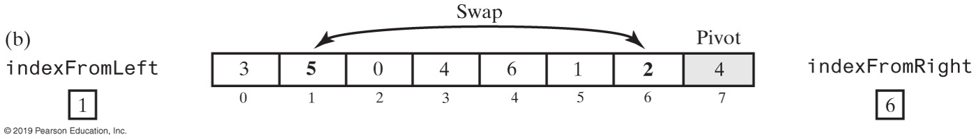
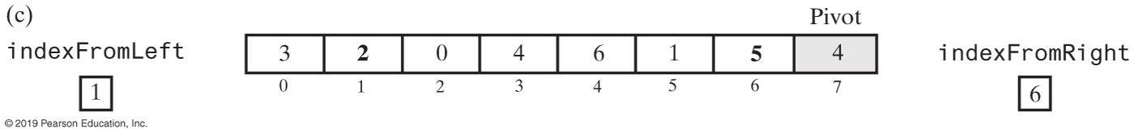
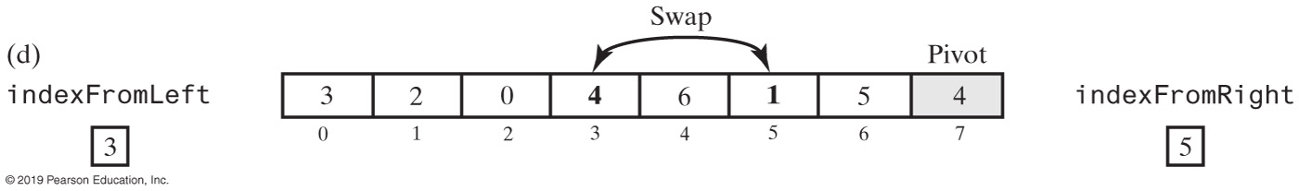
Quick Sort Partitioning (1 of 2)

Slide 30
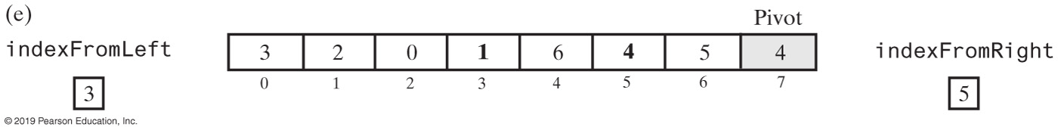
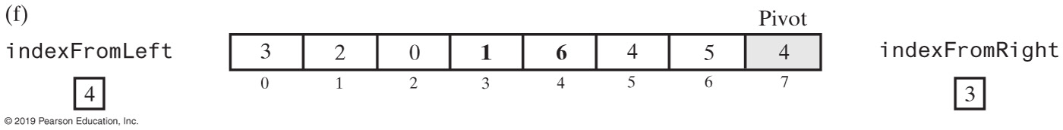
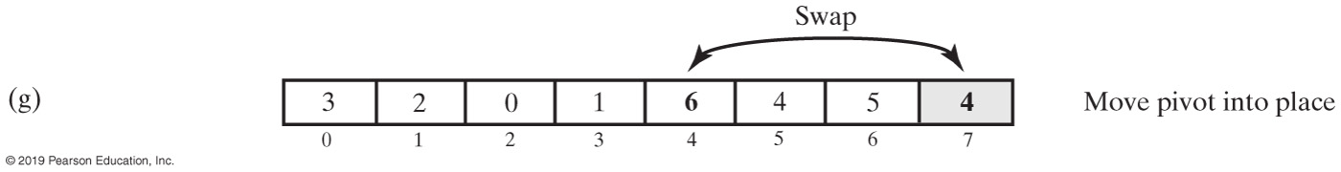
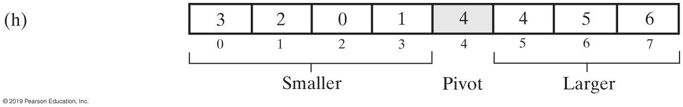
Quick Sort Partitioning (2 of 2)

Slide 31
Activity: Quick Sort
Index
0 | 1 | 2 | 3 | 4 | 5 | 6 | 7 | 8 | 9 | 10 | 11 | 12
123 | 398 | 210 | 19 | 528 | 3 | 49 | 99 | 513 | 129 | 7 | 220 | 294

Slide 32
Quick Sort | Java Class Library
Class Arrays in the package java.util defines versions of a static method sort
public static void sort(type[] a)
public static void sort(type[] a, int first, int after)

Slide 33
Radix Sort (1 of 3)
Does not use comparison
Treats array entries as if they were strings that have the same length
Group integers according to their rightmost character (digit) into “buckets”
Repeat with next character (digit), etc.

Slide 34
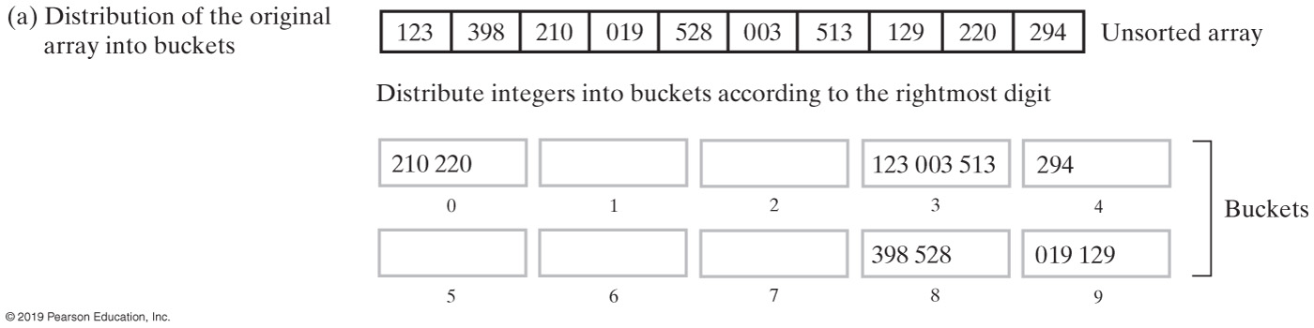
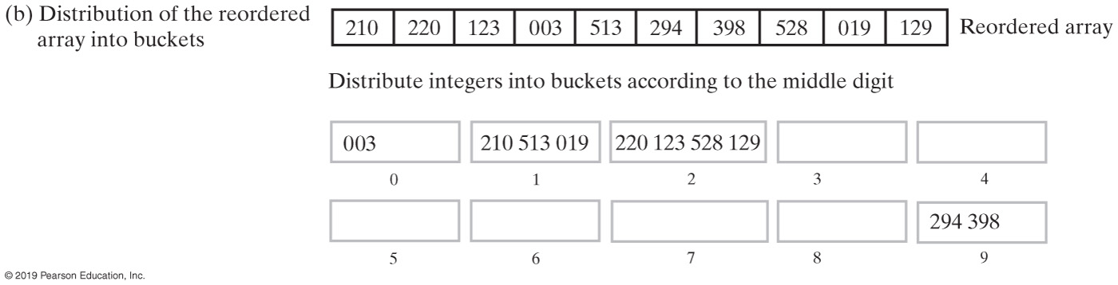
Radix Sort (2 of 3)

Slide 35
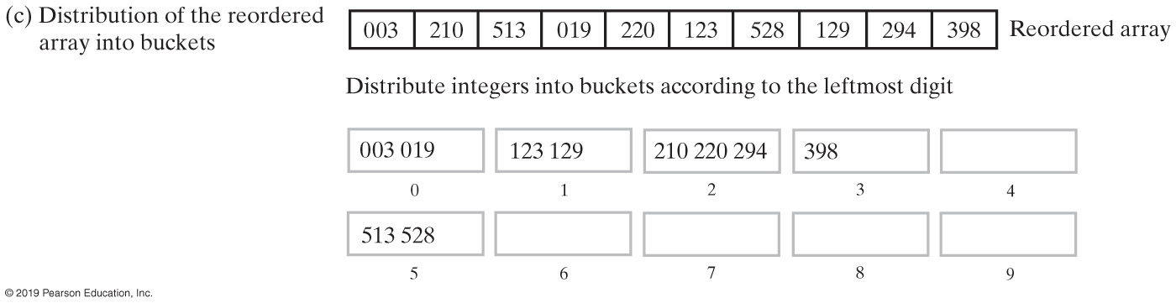
Radix Sort (3 of 3)

Slide 36
Activity: Radix Sort
Index
0 | 1 | 2 | 3 | 4 | 5 | 6 | 7 | 8 | 9 | 10 | 11 | 12
123 | 398 | 210 | 19 | 528 | 3 | 49 | 99 | 513 | 129 | 7 | 220 | 294

Slide 37
Algorithm Comparison
 | Best Case | Average Case | Worst Case
Radix Sort | O(n) | O(n) | O(n)
Merge Sort | O(n log n) | O(n log n) | O(n log n)
Quick Sort | O(n log n) | O(n log n) | O(n²)
Shell Sort | O(n) | O(n^{1.5}) | O(n^{1.5})
Insertion Sort | O(n) | O(n²) | O(n²)
Selection Sort | O(n²) | O(n²) | O(n²)
The time efficiency of various sorting algorithms, expressed in Big Oh notation

Slide 38
Binary Tree Sort (1 of 3)
Items to be sorted are inserted into a Binary Search tree (BST)
An LNR (inorder) traversal visits the items in ascending order
An RNL traversal visits the items in descending order
BST’s Insert algorithm
One of the few algorithms not to perform swaps
Sort can approach the O(nlogn) for a balanced tree
Search can approach the O(h)
38

Slide 39
Binary Tree Sort (2 of 3)
50
50
50
50
40
40
40
47
47
50
50
50
63
40
63
40
63
40
63
47
55
47
55
47
55
43
43
50
40
63
70, 80, 35, 68
35
47
55
70
43
68
80
39
Notes:
Data: 50, 40, 47, 63, 55, 43, 35, 70, 68 & 80

Slide 40
Binary Tree Sort (3 of 3)
Low when the items to be sorted are in random order (or close to randomized)
The tree is balanced
Zero comparisons for first item; < log2(n+1) comparisons per item for all subsequent items; O(nlog2n)
High when the items to be sorted are already sorted (or closed to sorted)
The tree is highly skewed
Zero comparisons for the first item, 1 for the second, 2 for the third, … n-1 for the nth; O(n^2)
5
3
7
2
4
6
9
2
4
7
9
40

Slide 41
Implementations

Slide 42
Merge Sort | Recursive (1 of 2)
Algorithm mergeSort(a, tempArray, first, last)
// Sorts the array entries a[first..last] recursively.
if (first < last)
{
mid = approximate midpoint between first and last
mergeSort(a, tempArray, first, mid)
mergeSort(a, tempArray, mid + 1, last)
Merge the sorted halves a[first..mid] and a[mid + 1..last] using the array tempArray
}

Slide 43
Merge Sort | Recursive (2 of 2)
Algorithm merge(a, tempArray, first, mid, last)
// Merges the adjacent subarrays a[first..mid] and a[mid + 1..last].
beginHalf1 = first endHalf1 = mid beginHalf2 = mid + 1 endHalf2 = last
// While both subarrays are not empty, compare an entry in one subarray with
// an entry in the other; then copy the smaller item into the temporary array
index = 0 // Next available location in tempArray
while ( (beginHalf1 <= endHalf1) and (beginHalf2 <= endHalf2) )
{
if (a[beginHalf1] <= a[beginHalf2])
{
tempArray[index] = a[beginHalf1] beginHalf1++
}
else
{
tempArray[index] = a[beginHalf2] beginHalf2++
}
index++
}
// Assertion: One subarray has been completely copied to tempArray.
Copy remaining entries from other subarray to tempArray
Copy entries from tempArray to array a

Slide 44
Merge Sort | Iterative
Less simple than recursive version.
Need to control the merges
Will be more efficient of both time and space
But, trickier to code without error

Slide 45
Quick Sort
Algorithm quickSort(a, first, last)
// Sorts the array entries a[first..last] recursively.
if (first < last)
{
Choose a pivot
Partition the array about the pivot
pivotIndex = index of pivot
quickSort(a, first, pivotIndex − 1) // Sort Smaller
quickSort(a, pivotIndex + 1, last) // Sort Larger
}

Slide 46
Quick Sort Partitioning (Part 1)
Algorithm partition(a, first, last)
// Partitions an array a[first..last] as part of quick sort into two subarrays named
// Smaller and Larger that are separated by a single entry—the pivot—named pivotValue.
// Entries in Smaller are <= pivotValue and appear before pivotValue in the array.
// Entries in Larger are >= pivotValue and appear after pivotValue in the array.
// Precondition: first >= 0; first < a.length; last – first >= 3; last < a.length.
// Returns the index of the pivot.
mid = index of the array’s middle entry
sortFirstMiddleLast(a, first, mid, last)
// Assertion: a[mid] is the pivot, that is, pivotValue;
// a[first] <= pivotValue and a[last] >= pivotValue, so do not compare these two
// array entries with pivotValue.
// Move pivotValue to next-to-last position in array Exchange a[mid] and a[last – 1]
pivotIndex = last – 1 pivotValue = a[pivotIndex]
Adjusting the Partition Algorithm

Slide 47
Quick Sort Partitioning (Part 2)
// Determine two subarrays:
// Smaller = a[first..endSmaller] and
// Larger = a[endSmaller+1..last–1]
// such that entries in Smaller are <= pivotValue and entries in Larger are >= pivotValue.
// Initially, these subarrays are empty.
indexFromLeft = first + 1 indexFromRight = last − 2
done = false
while (!done)
{
// Starting at the beginning of the array, leave entries that are < pivotValue and
// locate the first entry that is >= pivotValue. You will find one, since the last
// entry is >= pivotValue.
while (a[indexFromLeft] < pivotValue)
indexFromLeft++
// Starting at the end of the array, leave entries that are > pivotValue and
// locate the first entry that is <= pivotValue. You will find one, since the first
// entry is <= pivotValue.
while (a[indexFromRight] > pivotValue)
indexFromRight−−
Adjusting the Partition Algorithm

Slide 48
Quick Sort Partitioning (Part 3)
// Assertion: a[indexFromLeft] >= pivotValue and
// a[indexFromRight] <= pivotValue
if (indexFromLeft < indexFromRight)
{
Exchange a[indexFromLeft] and a[indexFromRight]
indexFromLeft++
indexFromRight−−
}
else
done = true
} // while (!done)
// Place pivotValue between the subarrays Smaller and Larger
Exchange a[pivotIndex] and a[indexFromLeft]
pivotIndex = indexFromLeft
// Assertion: Smaller = a[first..pivotIndex–1]
// pivotValue = a[pivotIndex]
// Larger = a[pivotIndex+1..last]
return pivotIndex

